Slide 1
Seeds’N’More:
ERP Proposal

Slide 2
Meet Seeds’N’More
Located in Southern Indiana
Produce and sell seeds and crops
Only ships seeds internationally
Currently approximately 3,000 employees
Annual revenue is $300 Million

Slide 3
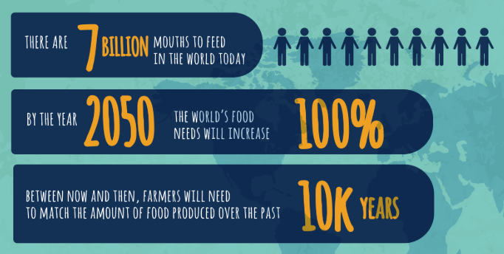
Challenges in Agriculture

Slide 4
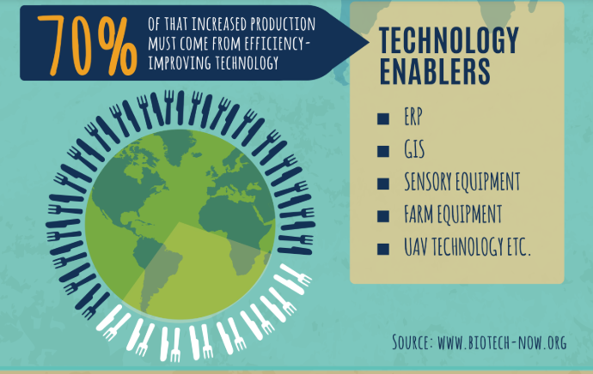

Slide 5
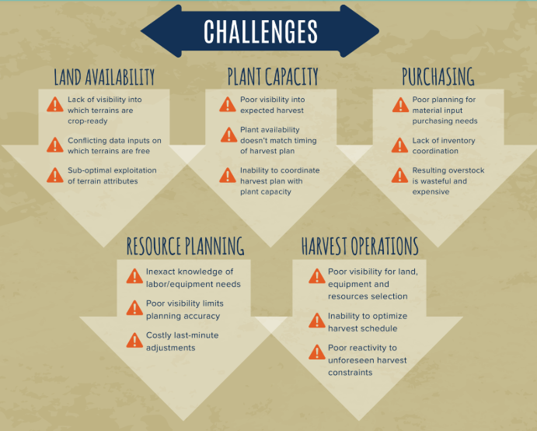

Slide 6
Challenges of Seeds’N’More
New Merge
New Facilities
New Employees
New Sensor Technology Growth
Internet of Things Implementation

Slide 7
ERP Systems
NetSuite by Oracle Cloud-Based ERP
SAP S/4HANA Cloud ERP
(with Vistex software solutions modules)

Slide 8
Typical Benefits of an ERP system
Improved integration & flexibility
Fewer Errors
Improved seed and efficiency
More complete access to information
Lower total costs in the complete supply chain
Shortened throughput times
More accurate data & data analysis

Slide 9

NetSuite
Pros:
Cloud-based
Multi-location
Microsoft Office compatible
Real-time data interaction
PBC Service
Built in Business Intelligence
Multi-currency support
Documentation
Batch and Lot tracking
Cons:
Cost ($999 License, $99 base user/month)
No Agricultural Specific solutions
Manufacturing Focused

Slide 10
SAP S/4HANA Cloud ERP
Pros:
Cloud-based
Internet of Things compatible
Software Solutions specifically for Agriculture (Vistex)
Microsoft Office Compatible
Built in Business Intelligence
Multi-currency support
Documentation
Inventory tracking
Scheduling and Planning features
Contract Management
Chemical Application & Irrigation Tracking
Cons:
Cost ($220 per user/month)
Possible lengthy Implementation

Slide 11
Why SAP?
Vistex Farm Management Software Solutions can be used on top to the SAP ERP system. They provide amazing features, such as Chemical Application Tracking and more.
The cloud-based ERP is seeming more ideal for the use of the Internet of Things, for real-time data analysis on the go, and crop/harvest tracking features.

Slide 12
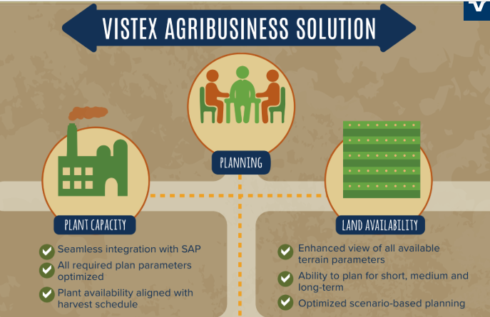

Slide 13
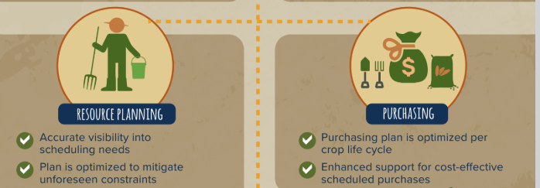

Slide 14
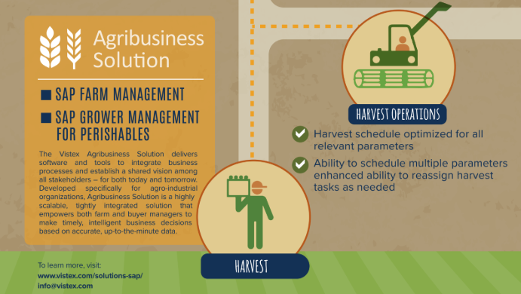

Slide 15
Implementation Procedure

Slide 16
Extensive training of lead employees should begin. Followed by the start of department training.
Vendor support and consultants should be on board. Testing is complete and go-live is successful
Allow for a year to merge and built support for the new ERP. Strategic Planning for ERP Begins and Develops
Merge Year
Year 1
Year 2
Year 3
Completion
Installation Begins with Consultants and others hired.
Data sifting and pre-testing should be completed. Employees should continue and finish training with proper help materials.

Slide 17
Closing Thoughts
Seeds’N’More with the proper management through their merge, ERP planning, and the implementation with consultants should be able to transfer to a new larger ERP system that will grow and expand as they maintain their new facilities, new employees, and their new use of sensor technology through the Internet of Things.
SAP S/4HANA Cloud ERP with the Farm Management software solutions from Vistex will serve Seeds’N’More and their needs well and will help their organization grow as their use of new technology grows.

